Slide 1
Trillium Woods
A key part of Kanata Lakes 40% Greenspace
May 2020
Neil Thomson
KGPC/KBCA

Slide 2
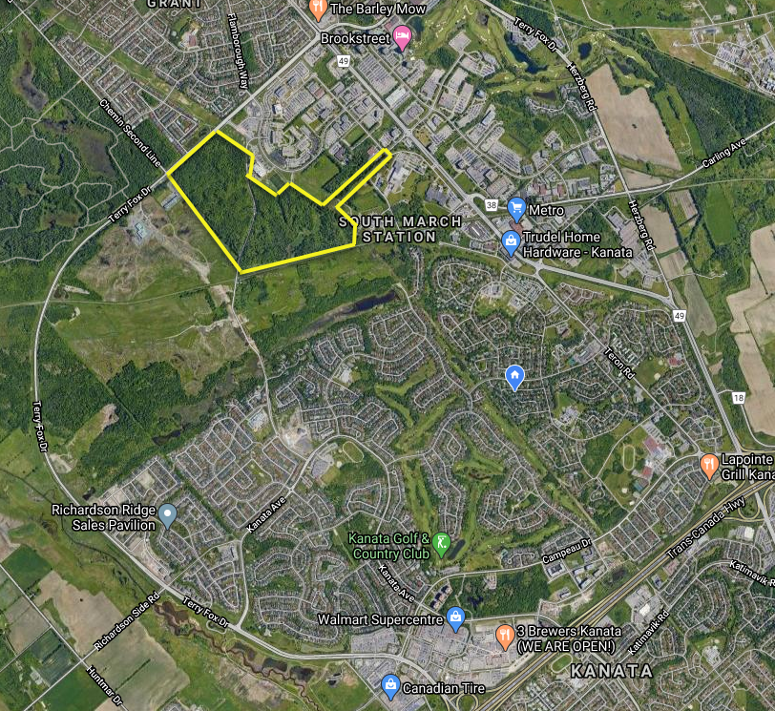
Trillium Woods is located within the original lands included in the 40% agreement, located below the Terry Fox Drive extension, North of Second Line Road and bounded by the properties on Innovation Drive, with entrances from the Richcraft Recreation Complex, off of the Goulbourn Forced Road and a path beside 1 Hines Rd.

Slide 3
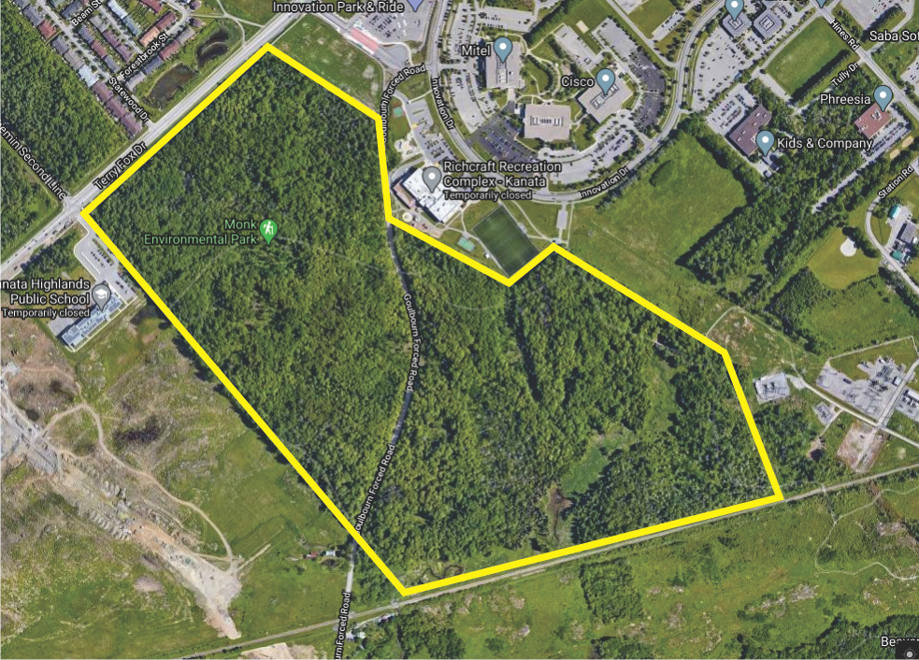

Slide 4
Trillium Woods Future
Trillium Woods is currently owned by one of the KNL lands developers who agreed to transfer the property to the City of Ottawa, but has not yet done so
As part of the 40% agreement, if Clublink ultimately strikes down the 40% agreement, there is real risk of the developer applying to redevelop it vs. transferring to the City
This may include redevelopment as a storm water pond as the overall KNL lands have drainage issues that are currently holding up all development

Slide 5
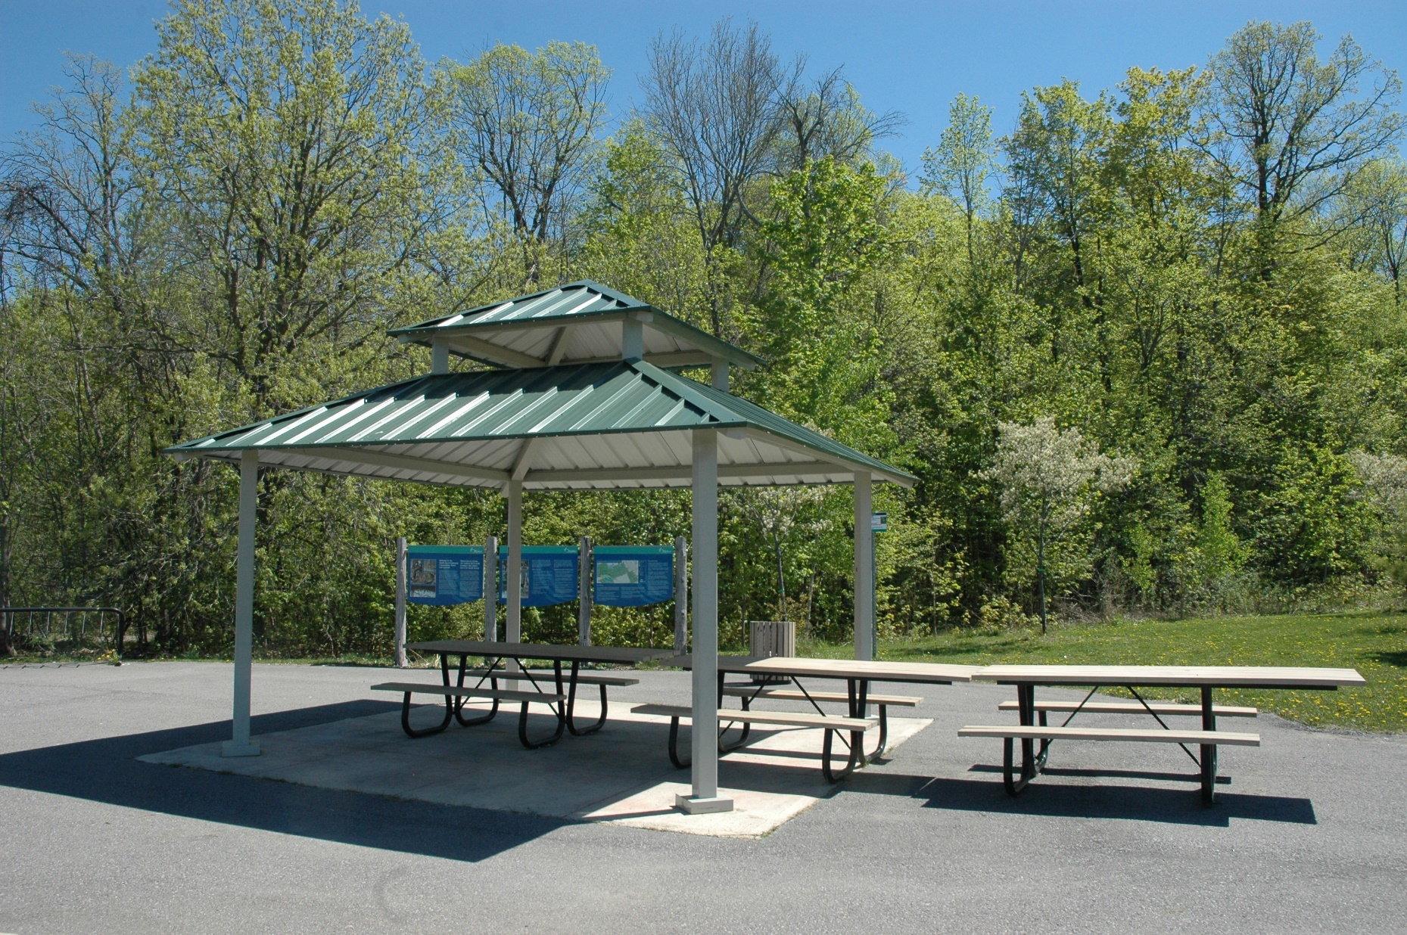
Picnic Area at edge of Trillium Woods, beside Richcraft Centre off of Innovation

Slide 6
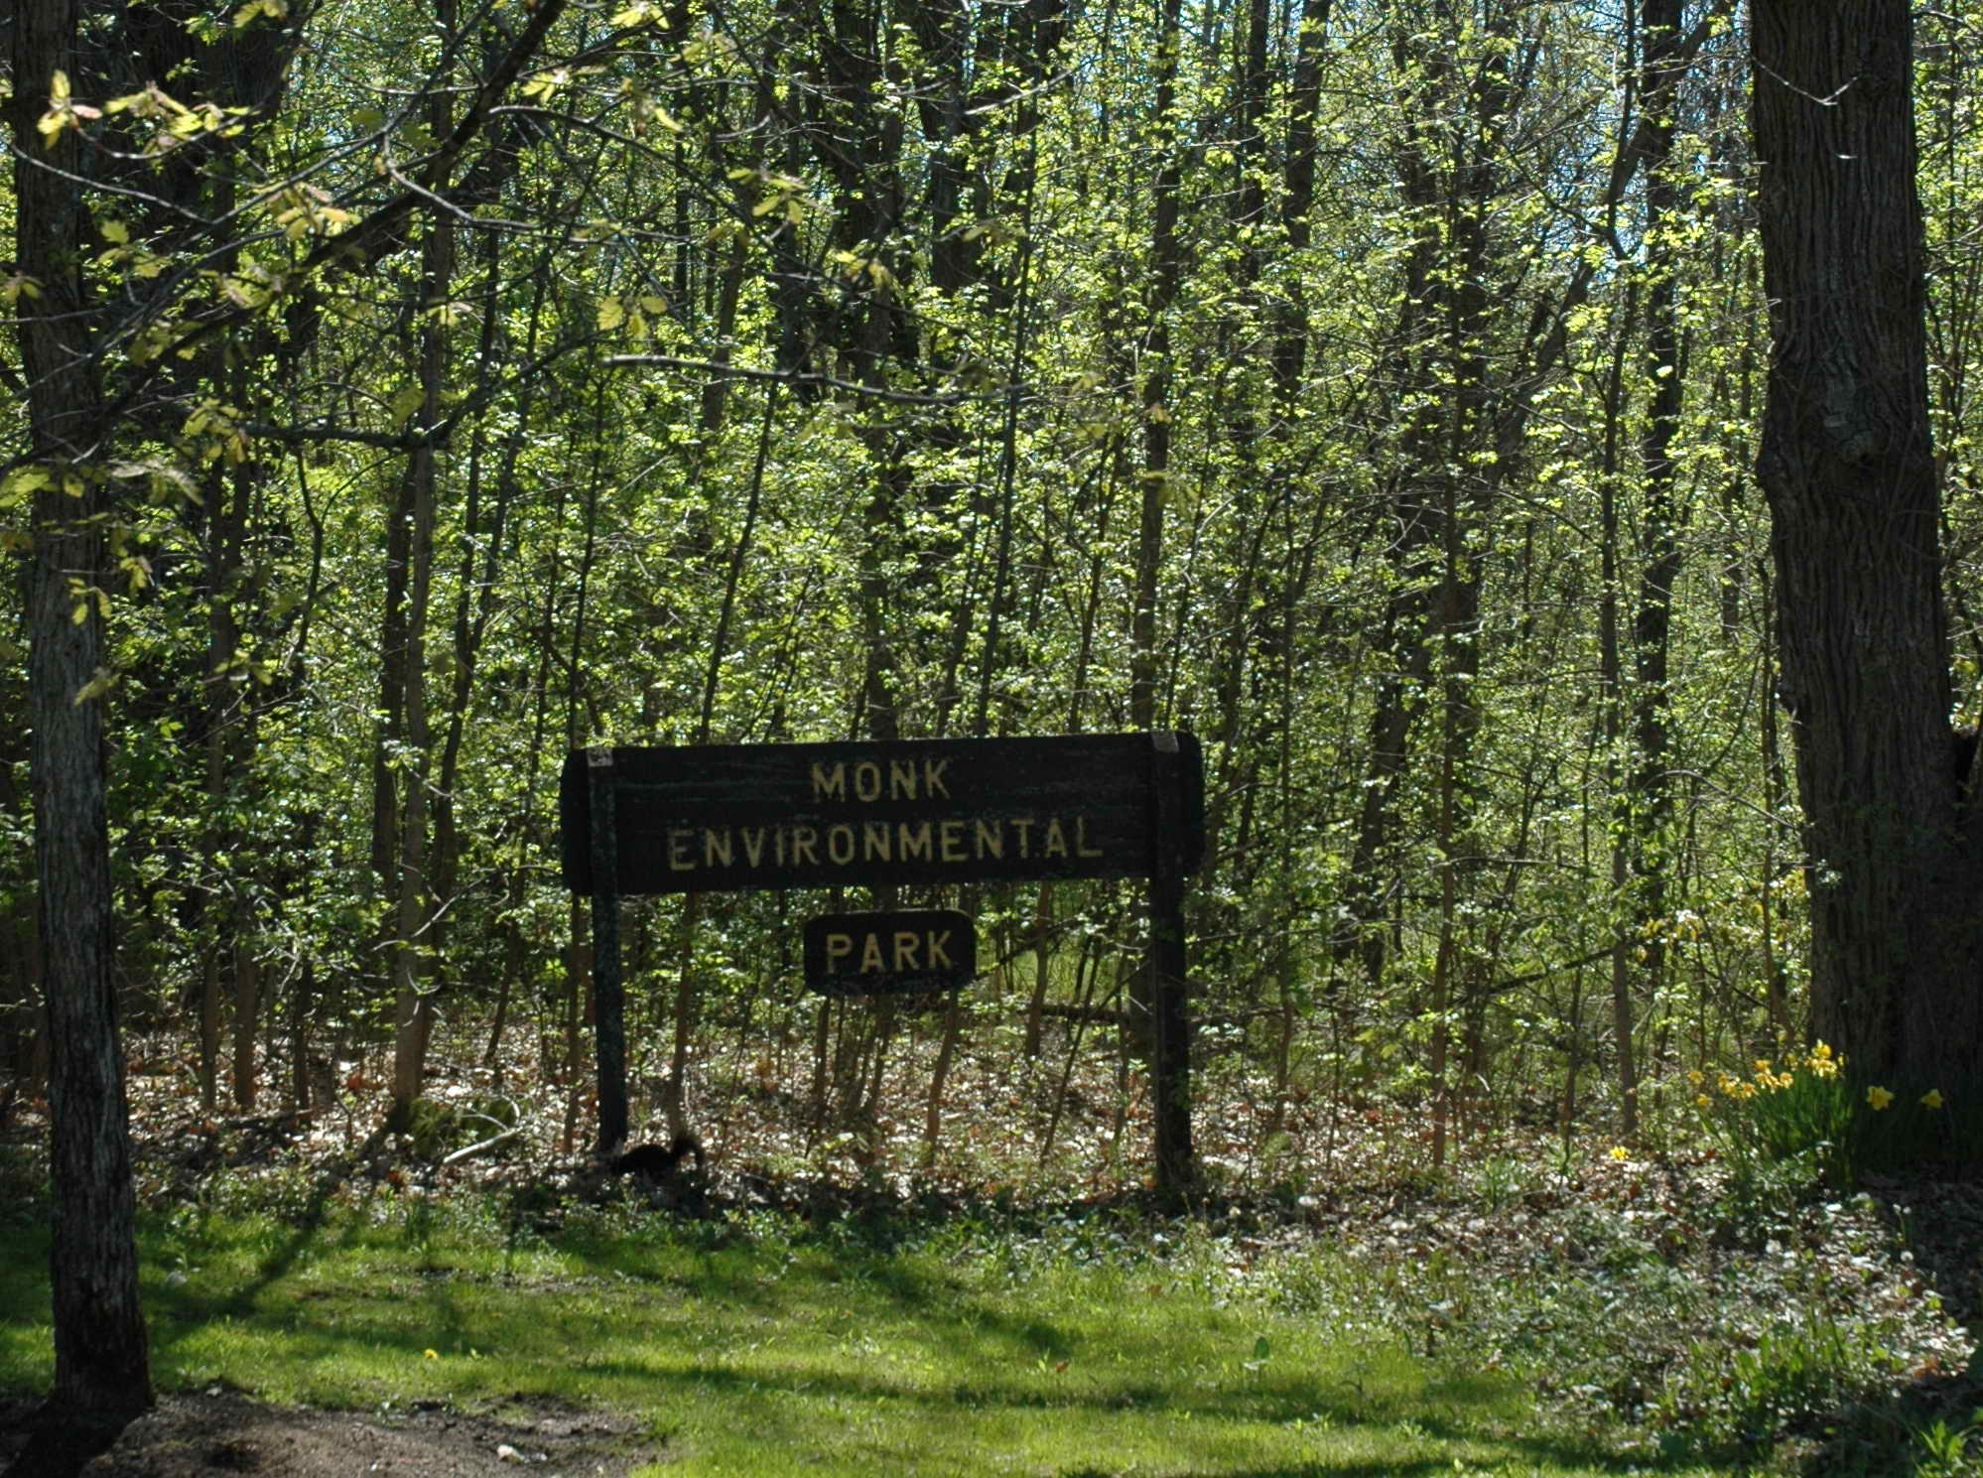
Trail entrance beside 1 Hines Rd

Slide 7
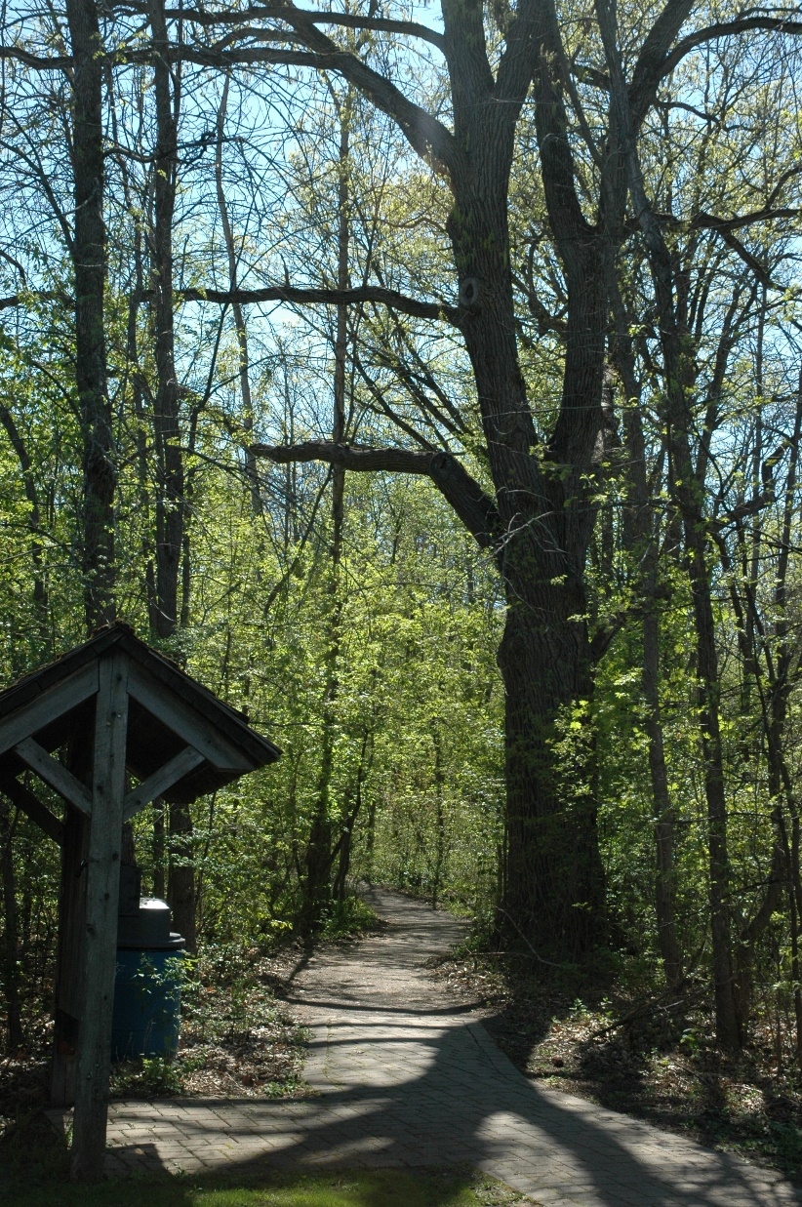

Slide 8
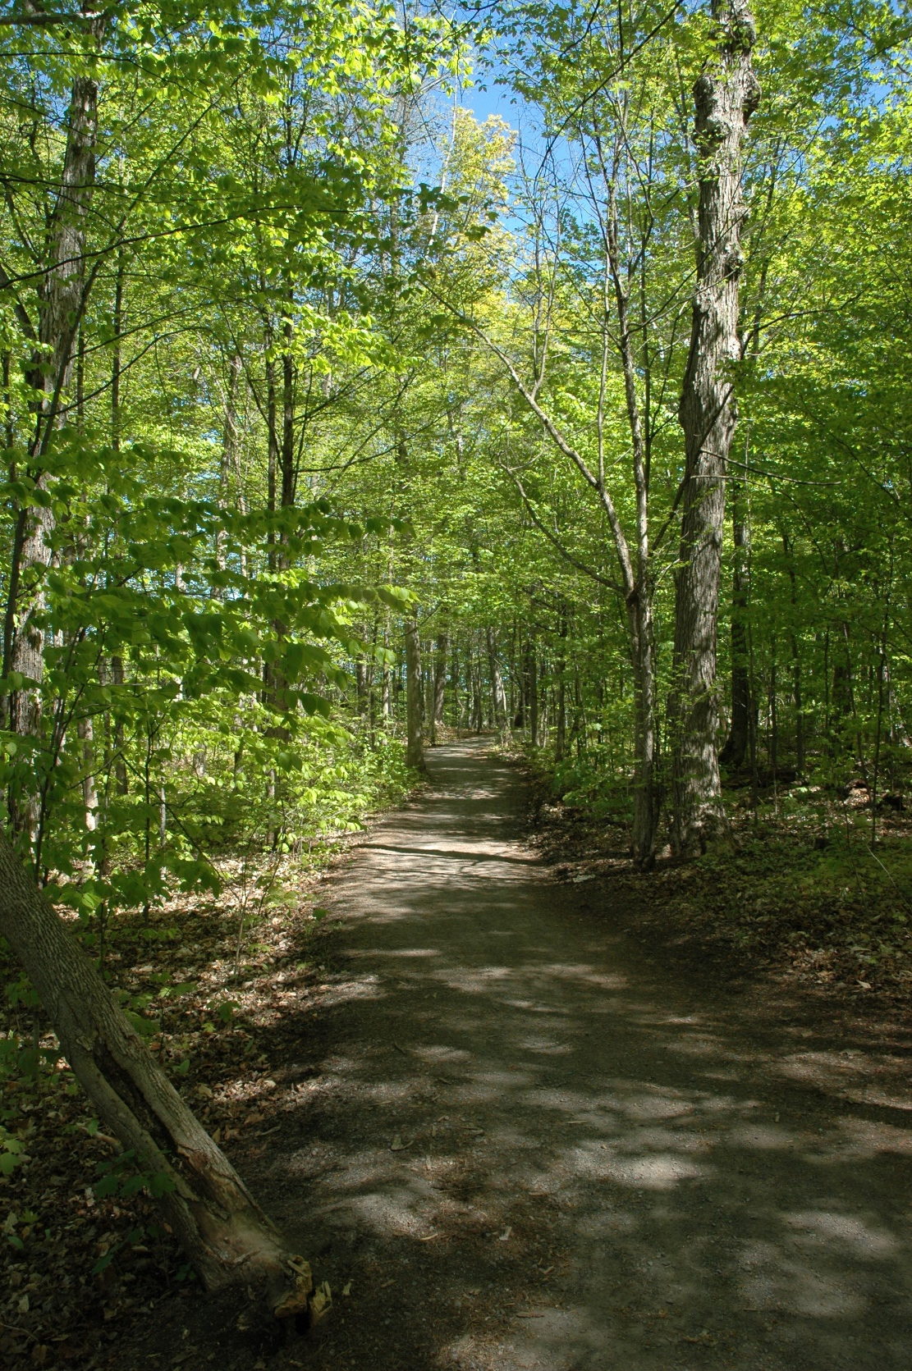

Slide 9
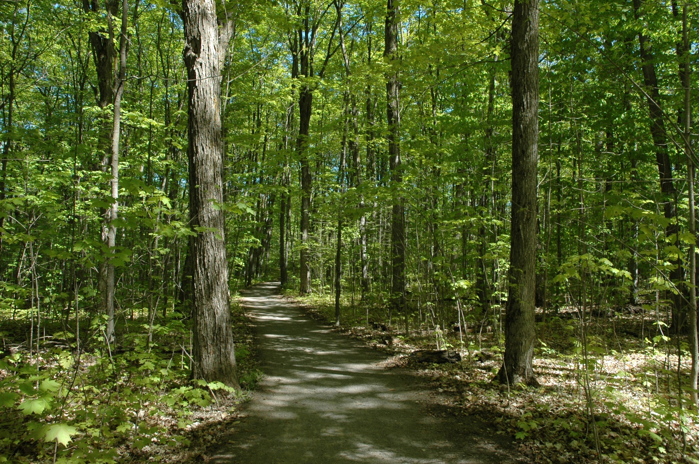

Slide 10
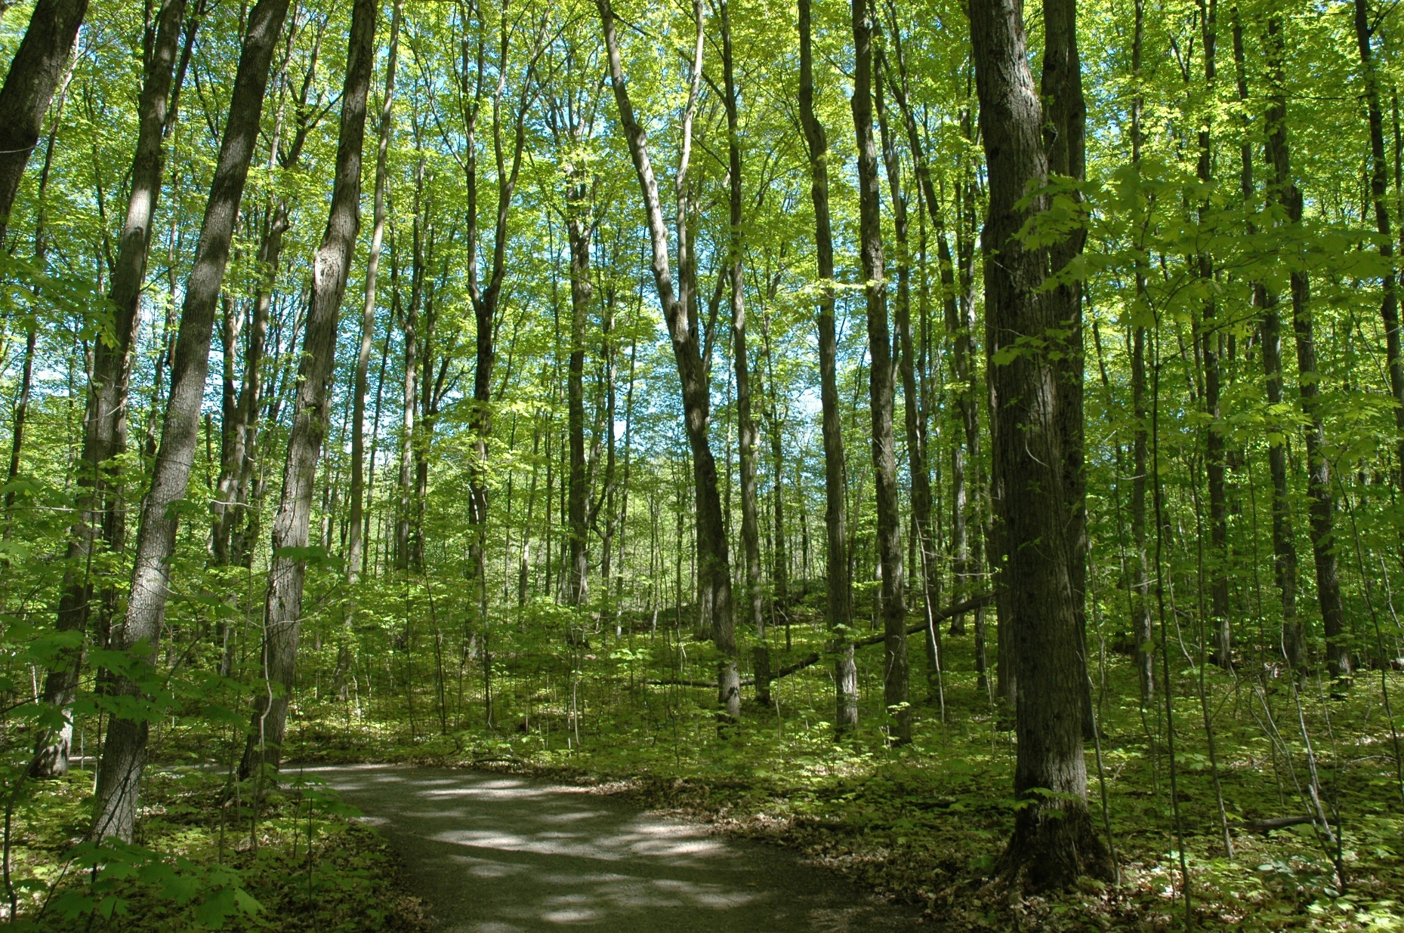

Slide 11
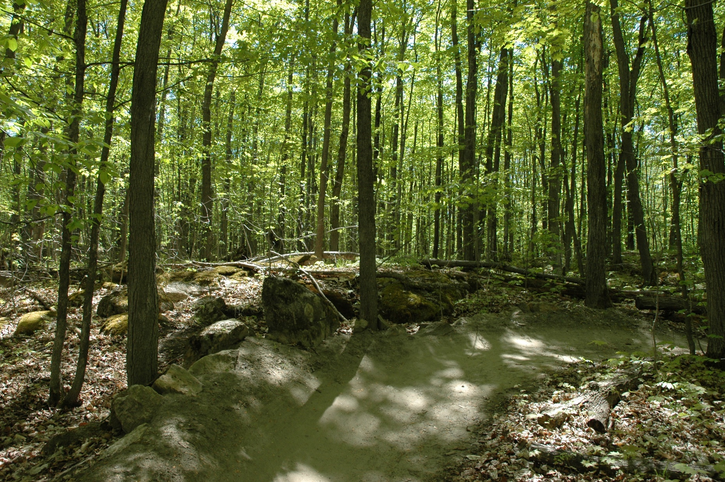

Slide 12
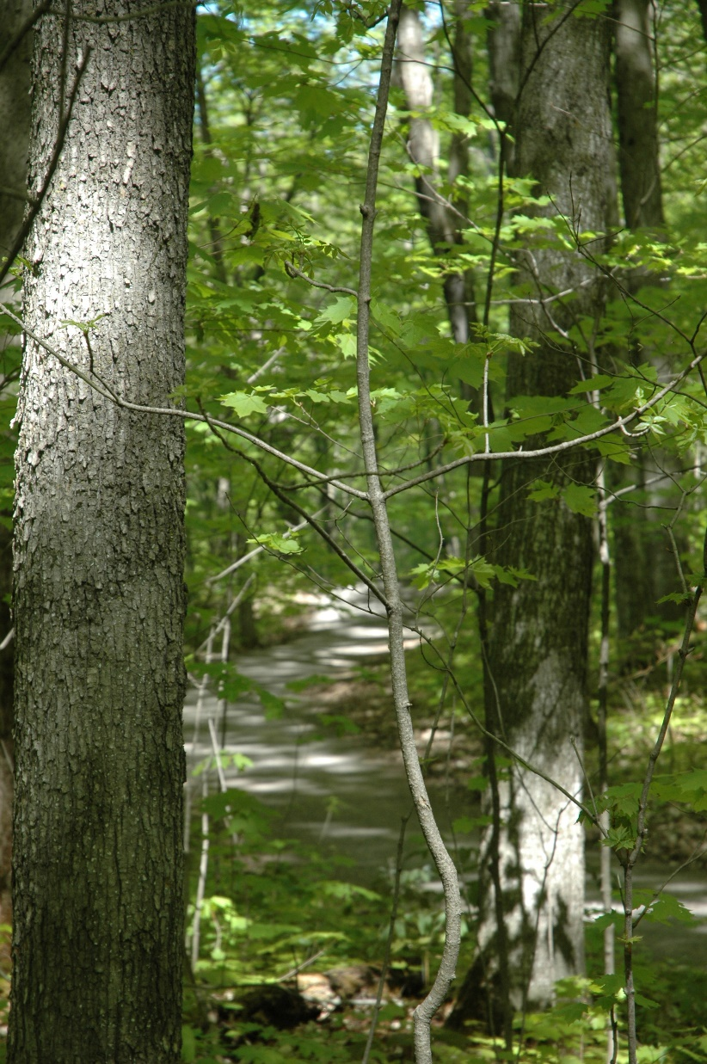

Slide 13
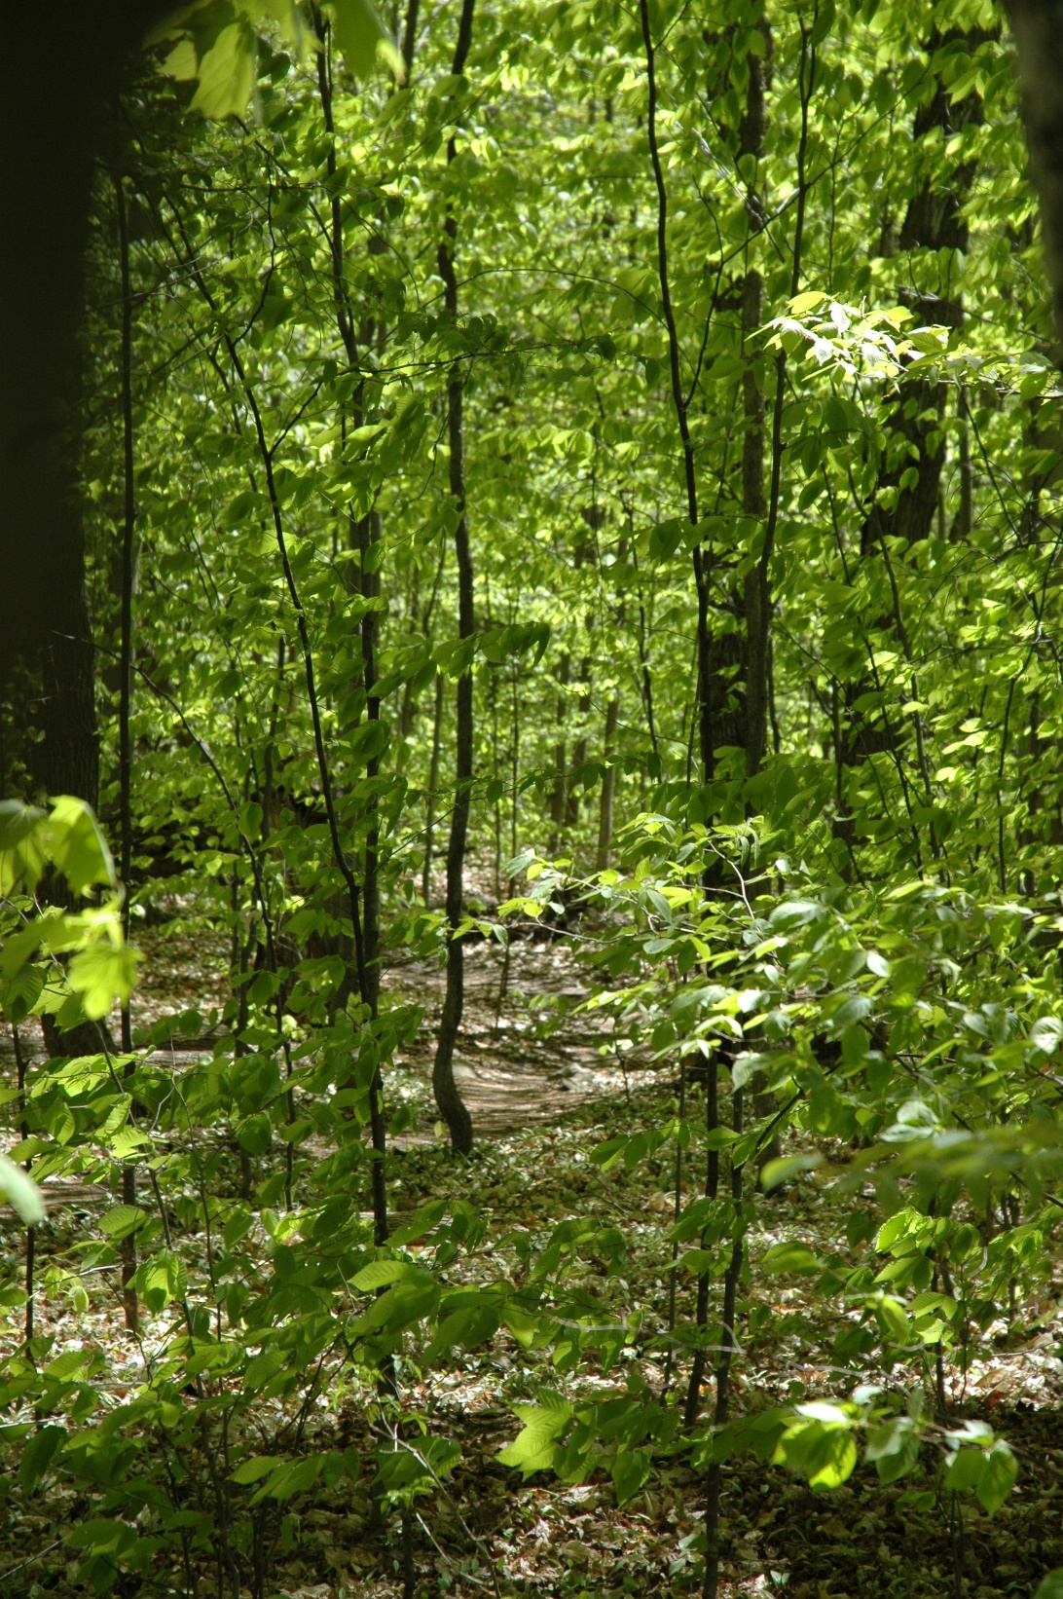

Slide 14
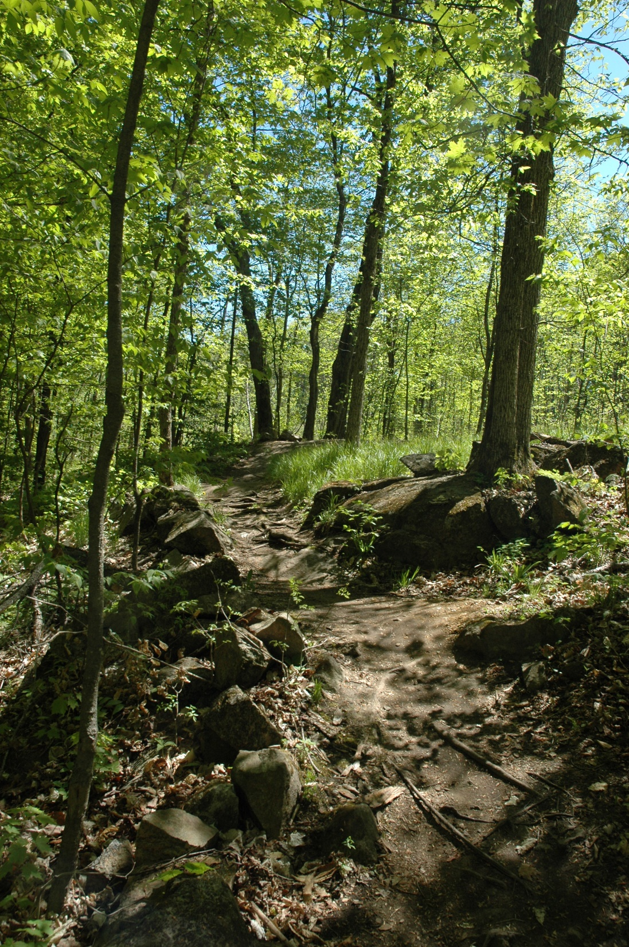

Slide 15
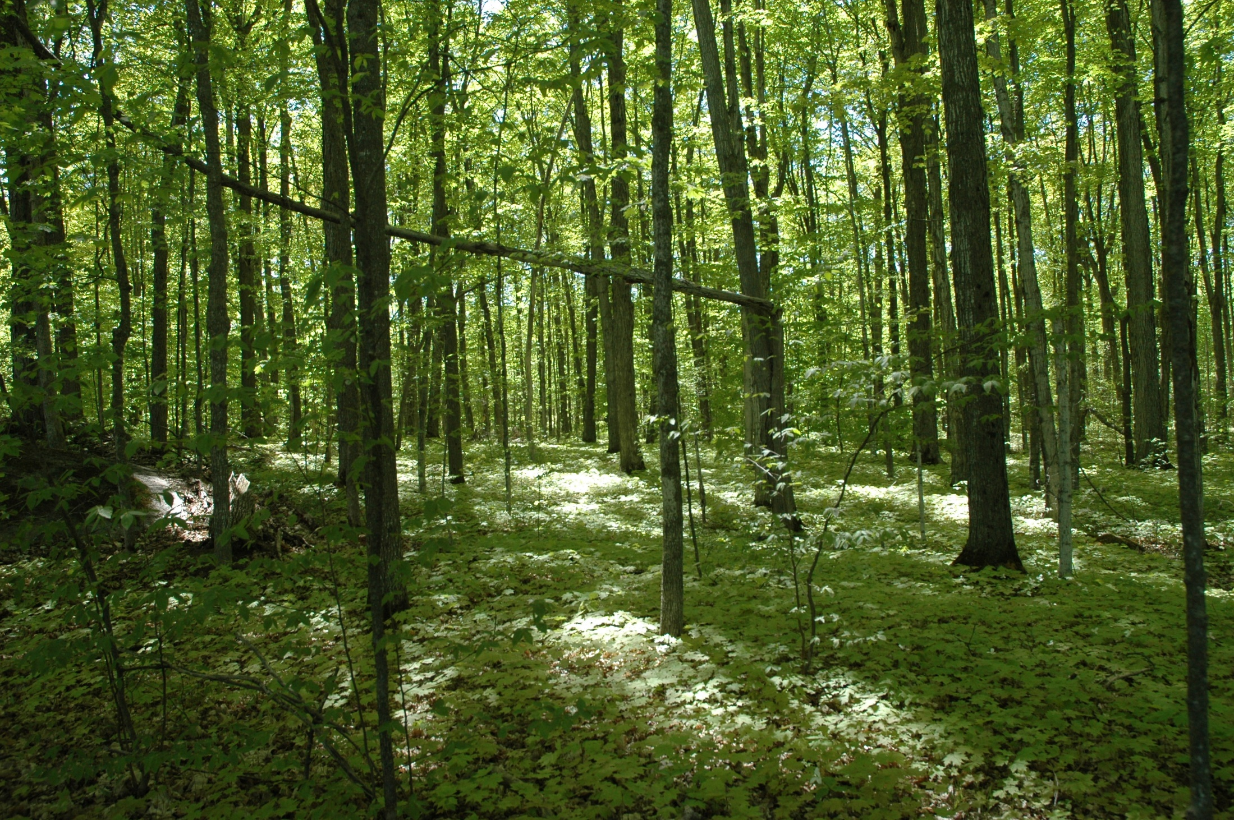

Slide 16
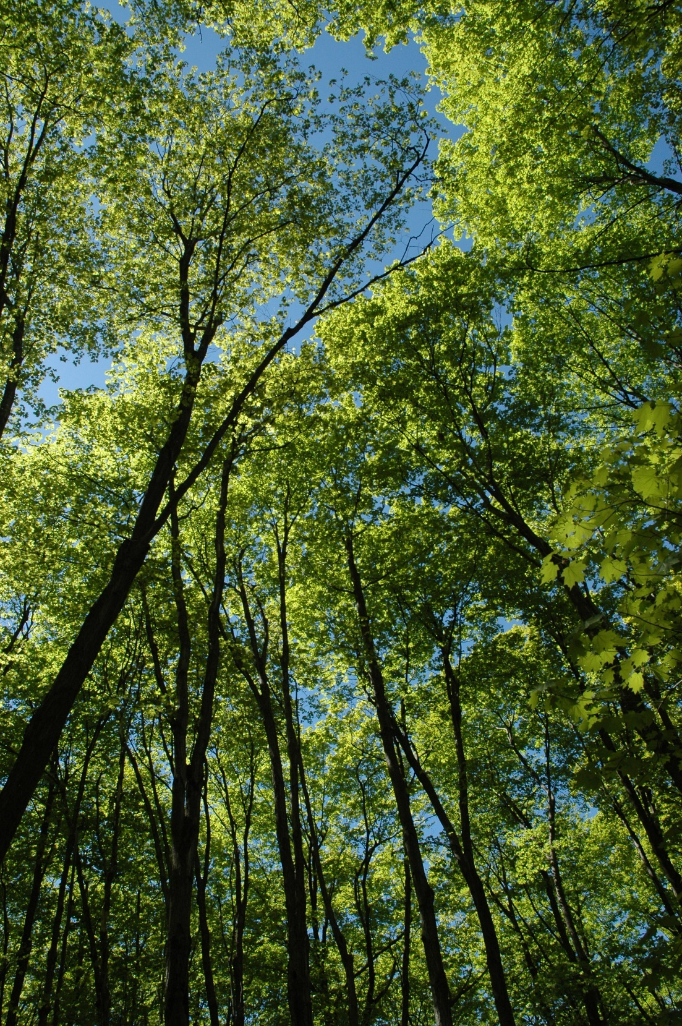

Slide 17
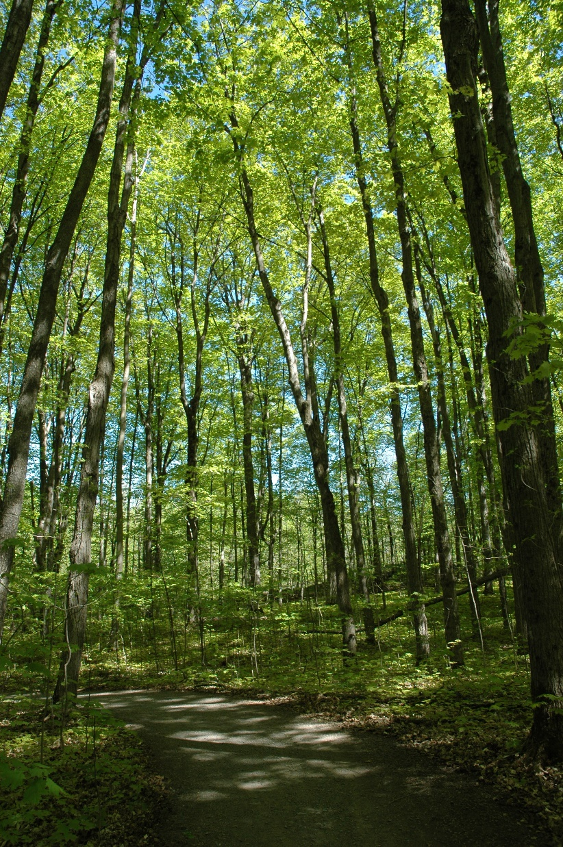

Slide 18
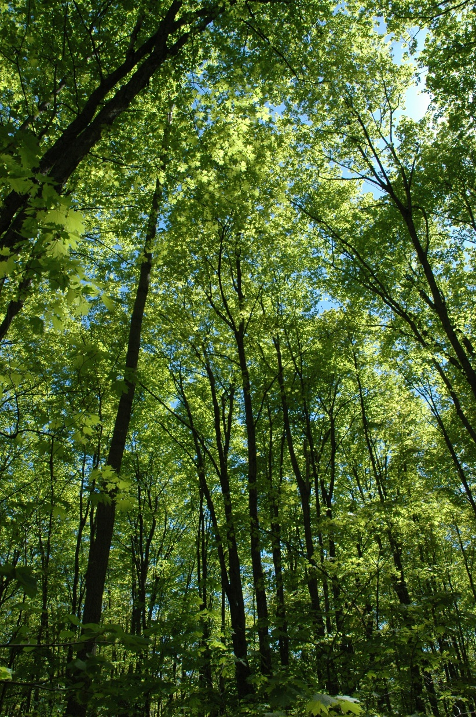

Slide 19
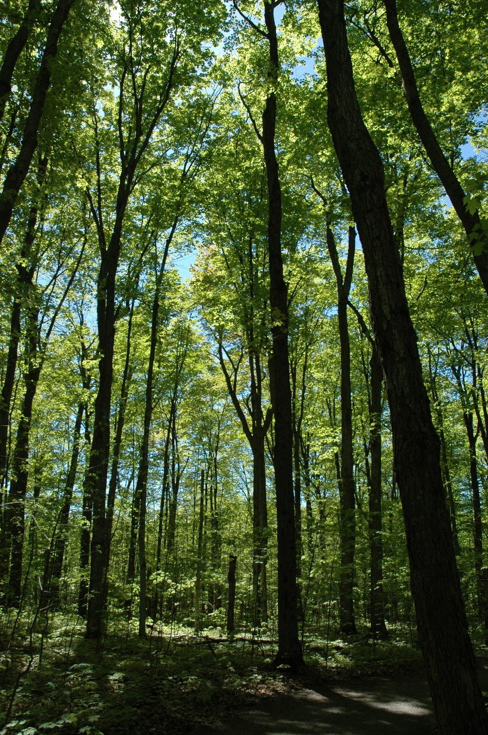

Slide 20
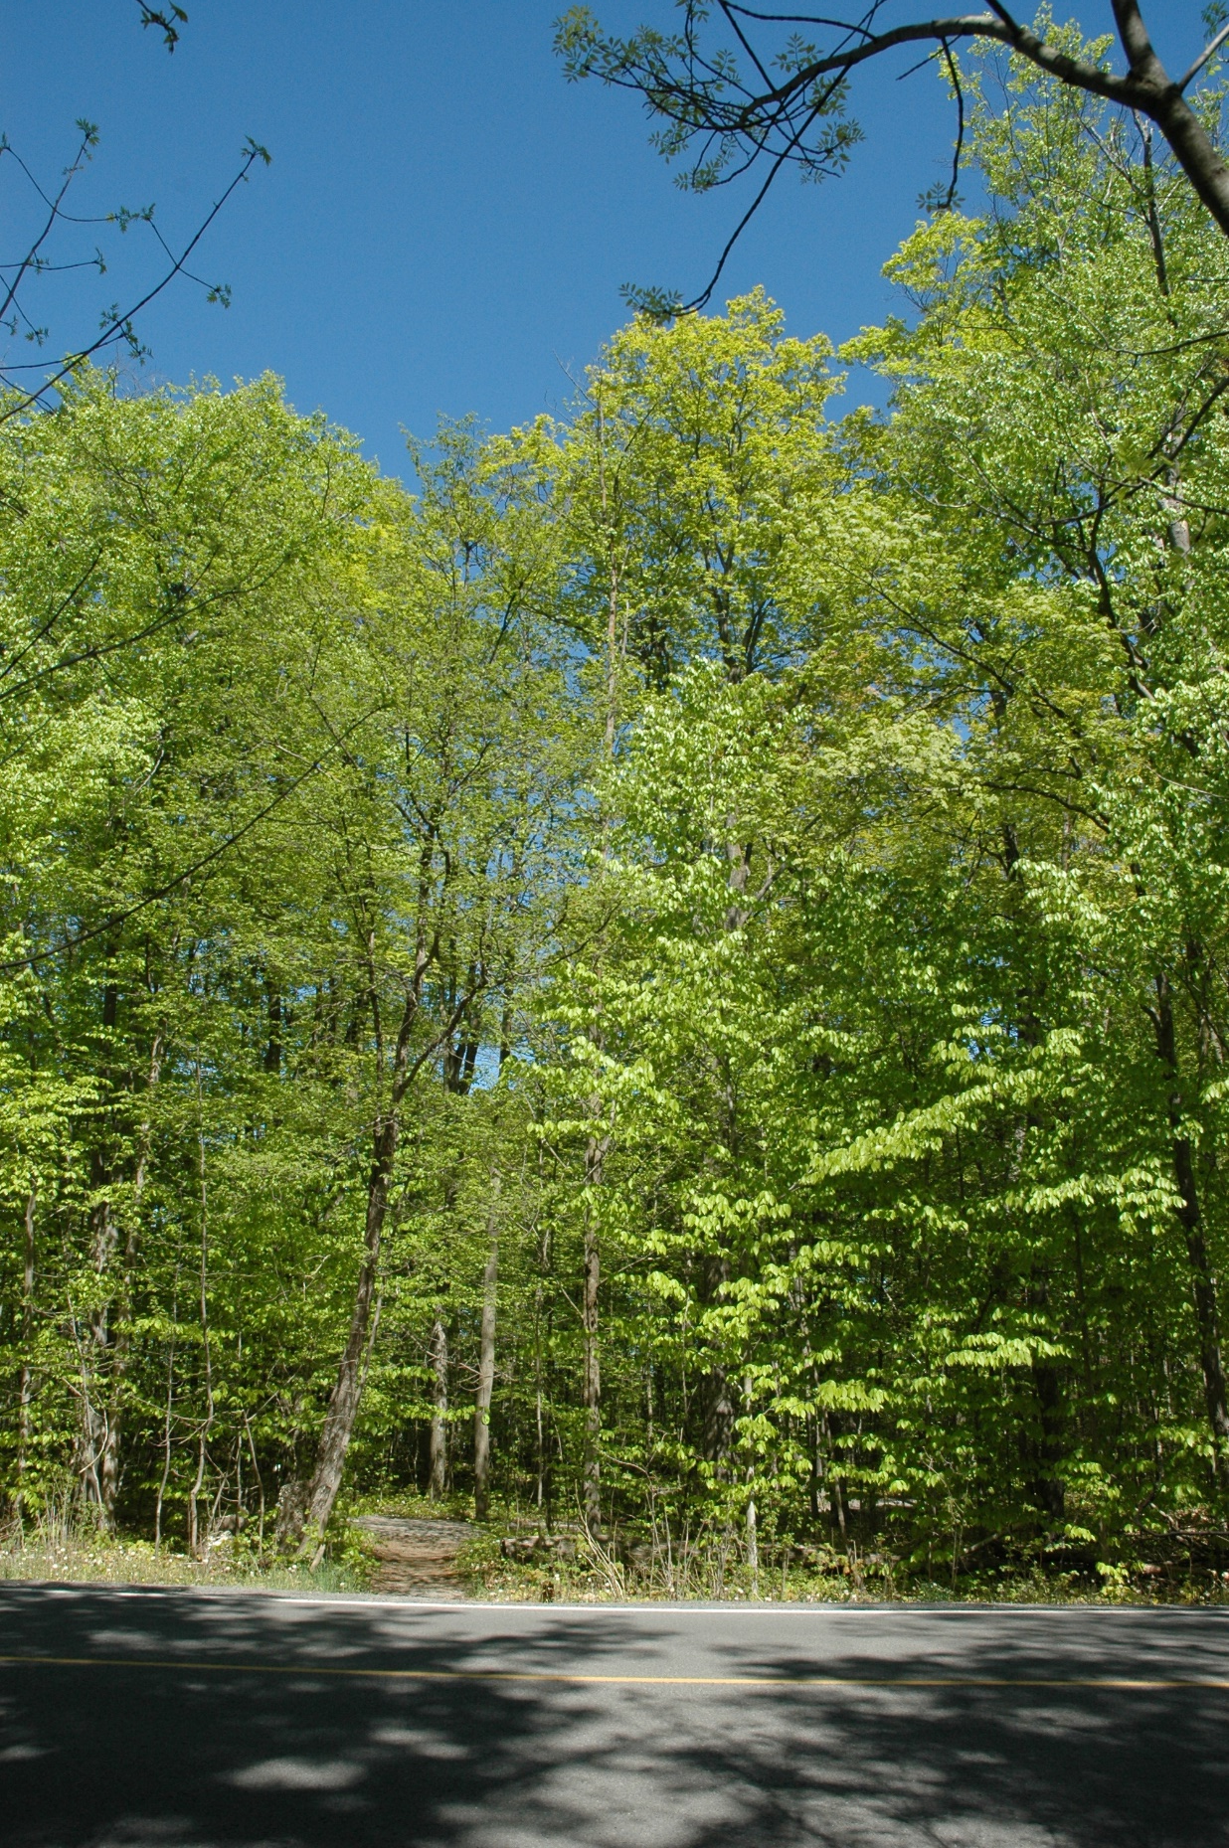

Slide 21
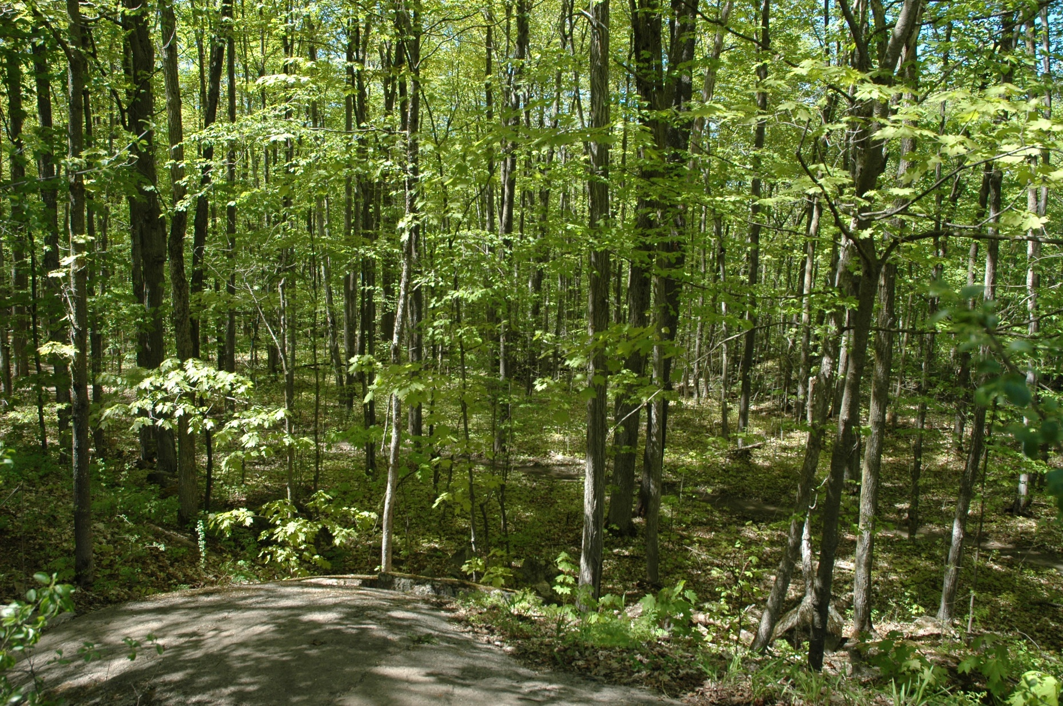

Slide 22
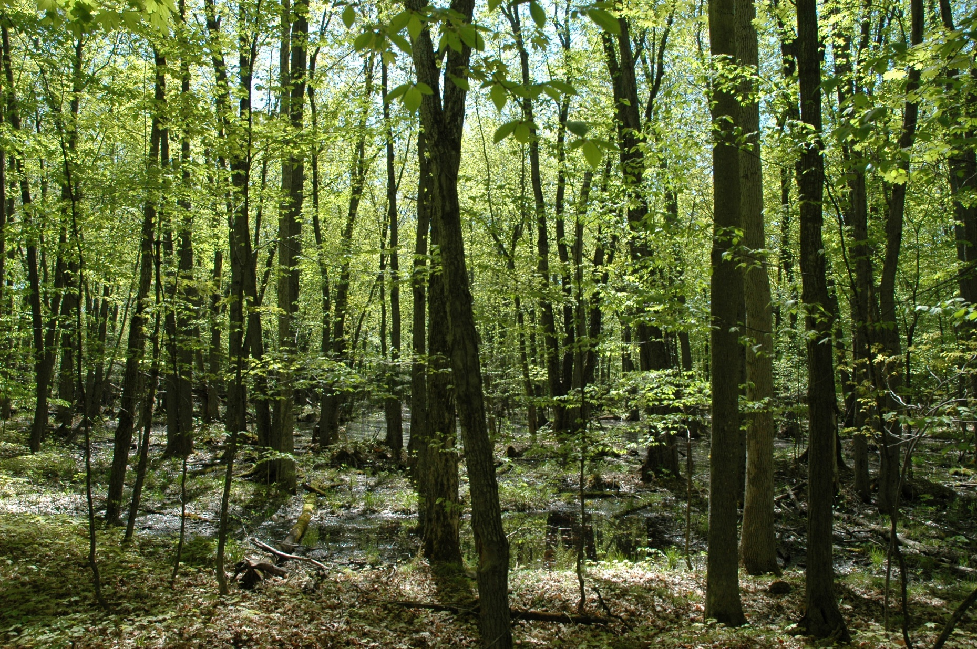

Slide 23
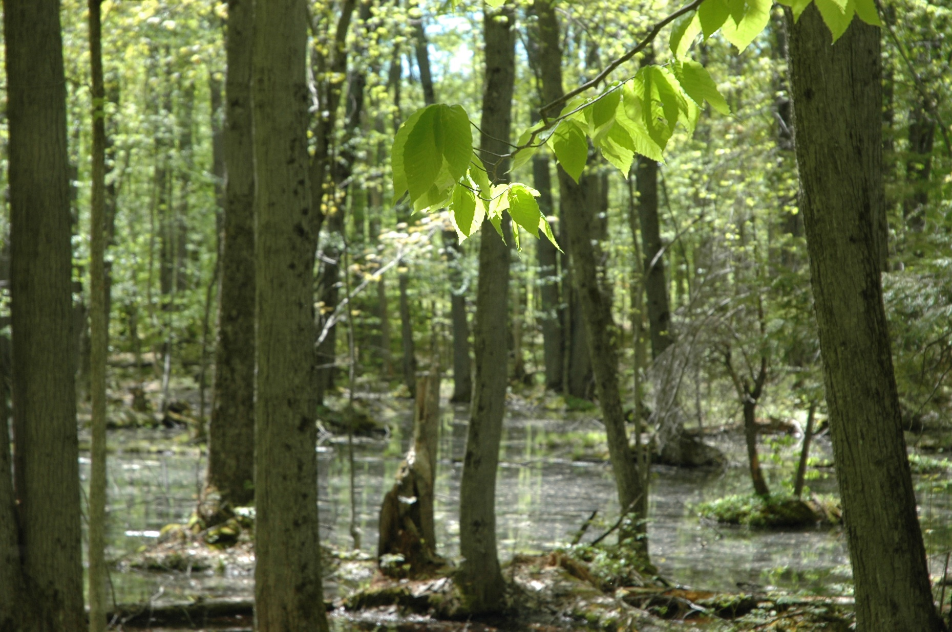

Slide 24
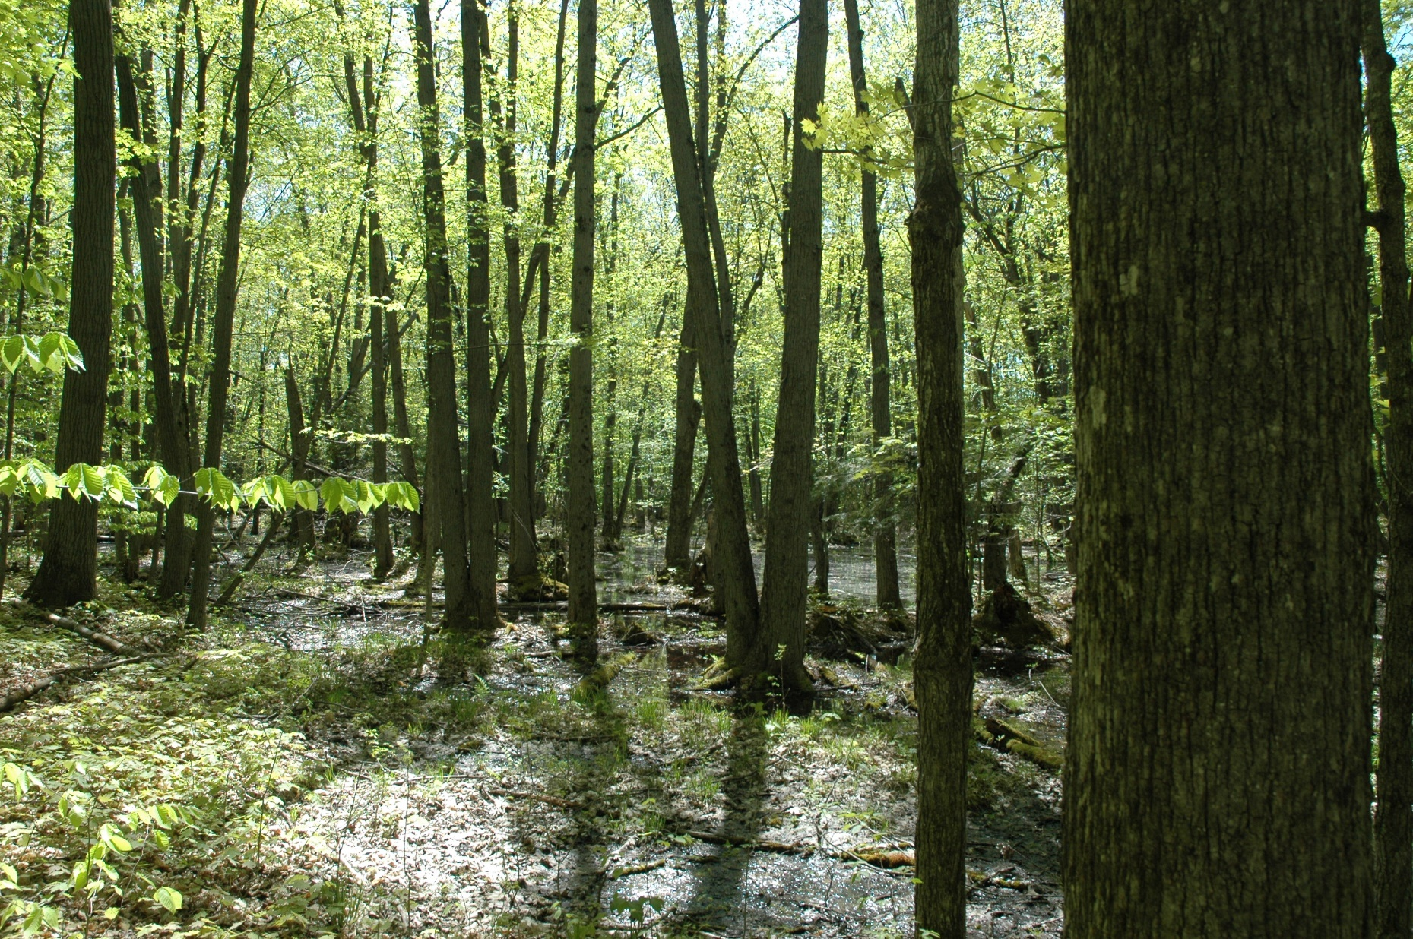

Slide 25
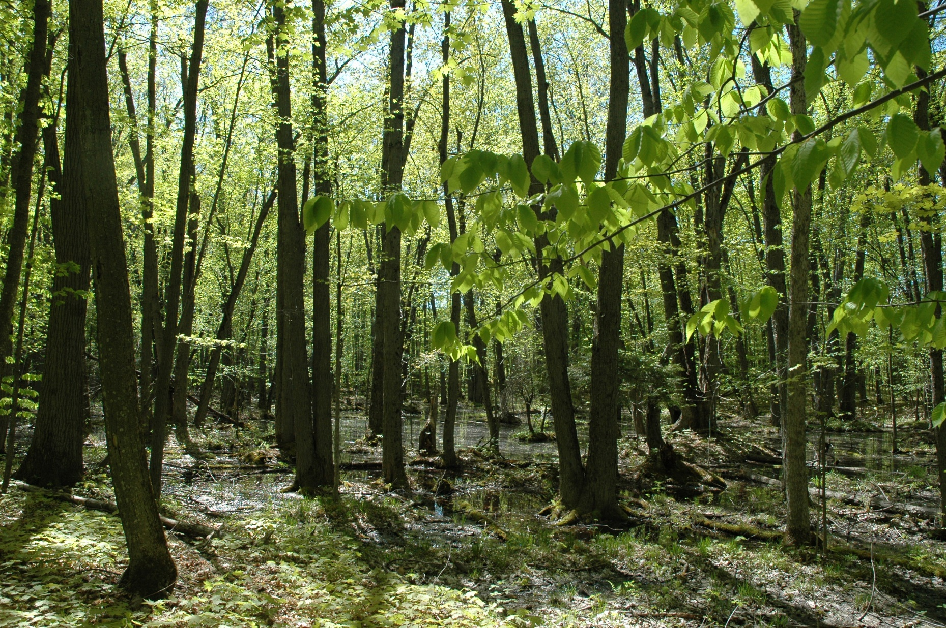

Slide 26
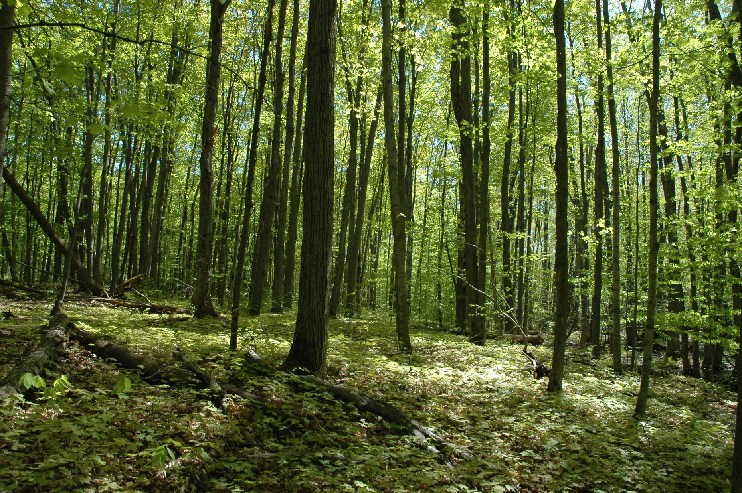

Slide 27
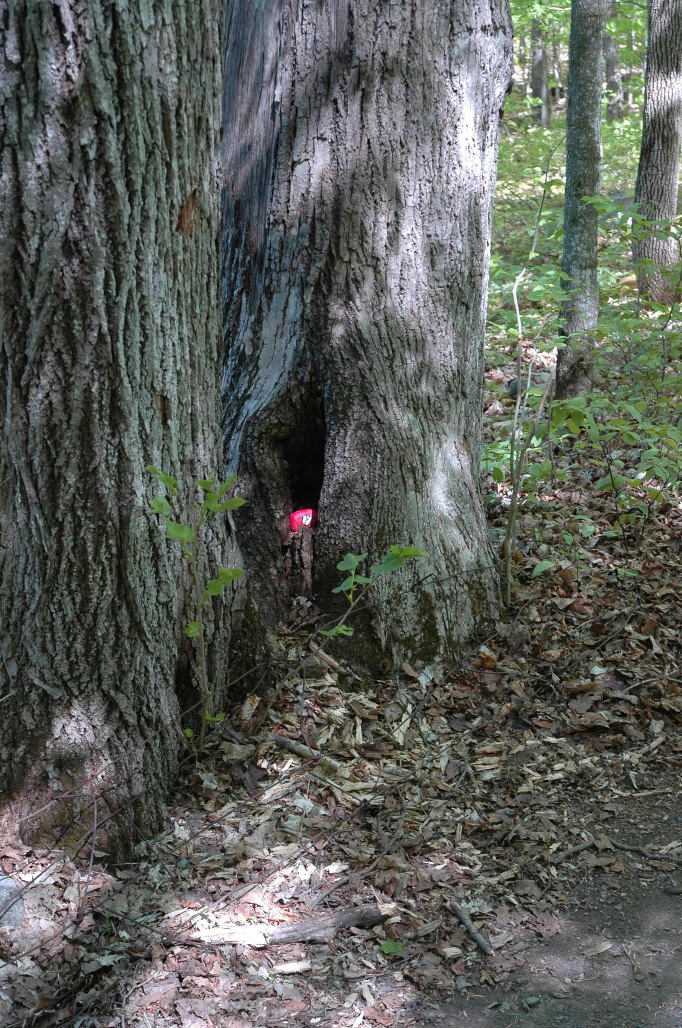

Slide 28
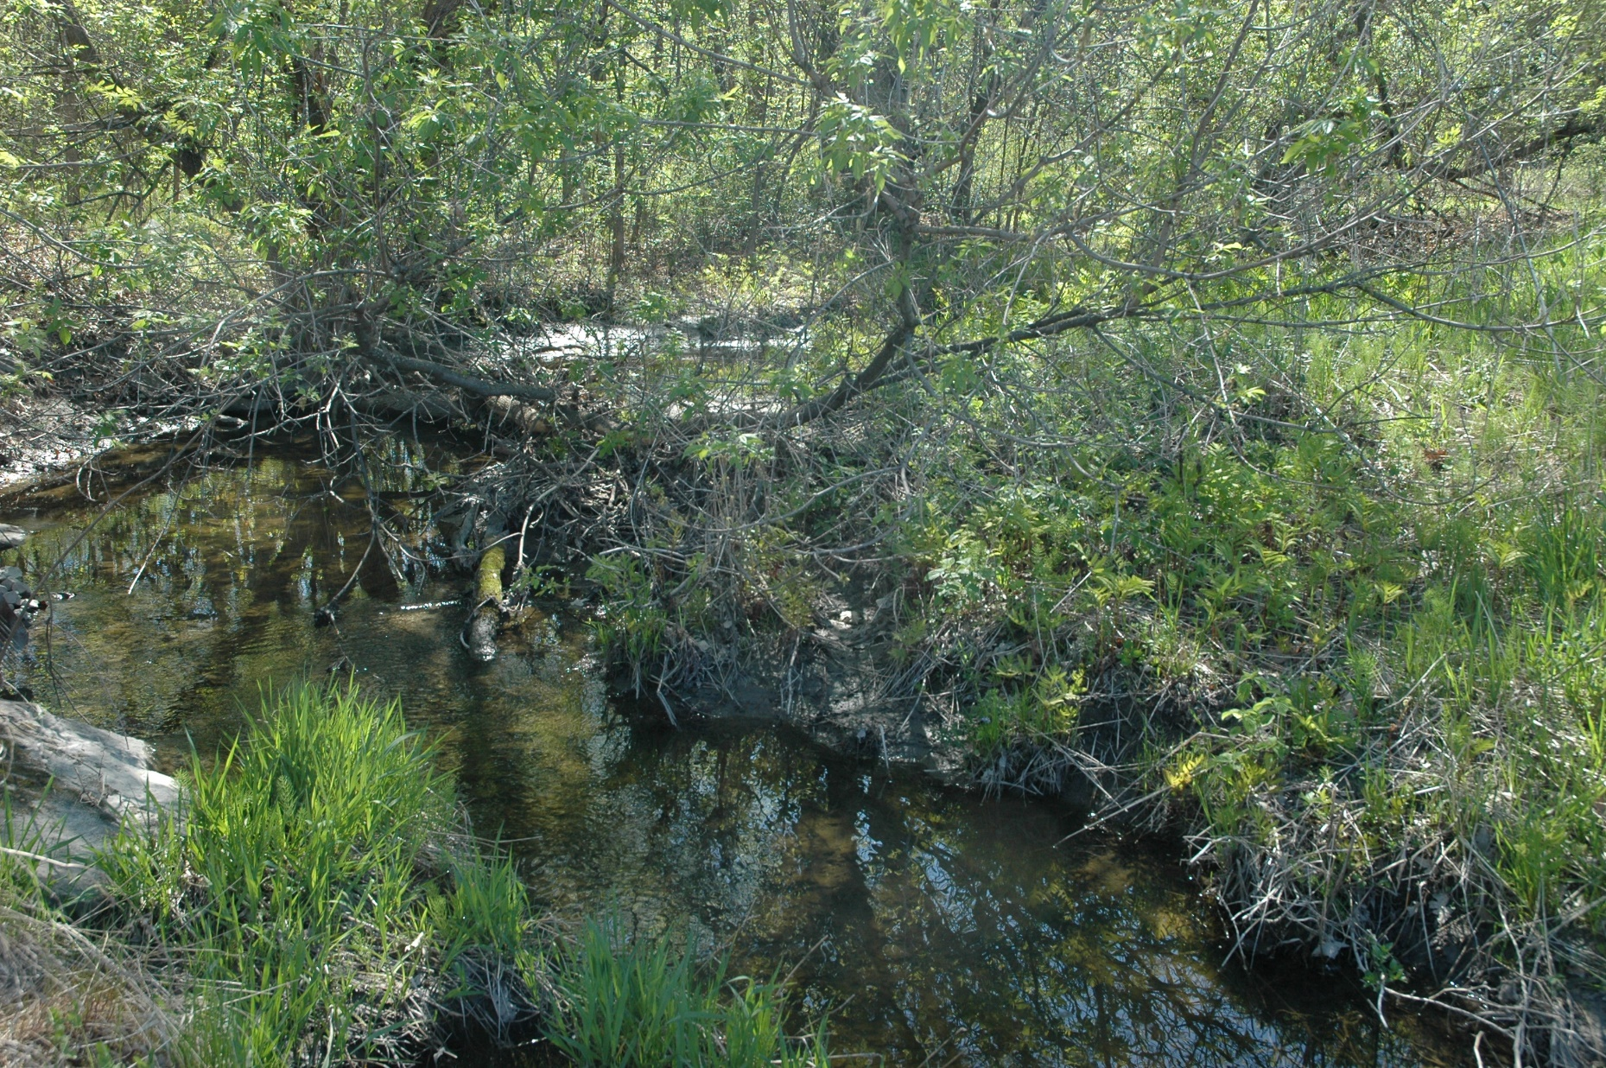
Creek under Hines Rd by Hines Road Trail Entrance

